Slide 1
Excelerate internship-2023
Week 3 Welcome – Presentation Design
Data Visualization approach

Slide 2
Agenda
Introduction
Campaign Objectives
Campaign Metrics Overview
Campaign Performance Overview
Age and Geography Analysis
Click-Through Rate (CTR) Analysis
Unique Clicks and Unique Link Clicks Analysis
Cost Analysis
Frequency Distribution
Key Insights and Recommendations
Conclusion

Slide 3
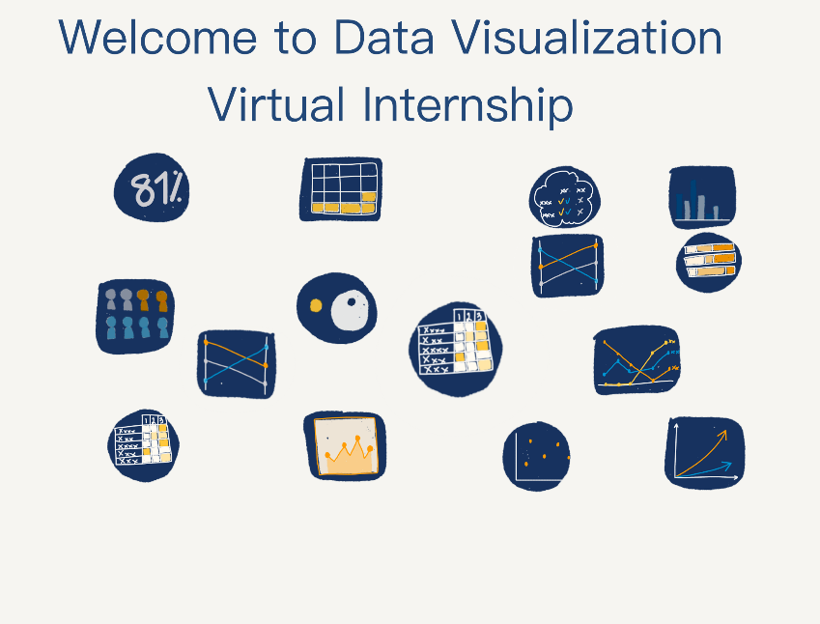
Introduction
Week 3- Campaign Performance Analysis!
.
Presented by:
YAMUNA V
August / 2023

Slide 4
Superhero U Event
Brief Explanation of Superhero U Event:
The Superhero U event is an annual gathering that celebrates superheroes and comic book culture.
It attracts fans, enthusiasts, and cos-players from around the world.
The event features various activities such as panel discussions, celebrity appearances, cos-play contests, and exclusive merchandise sales.
Superhero U aims to create an immersive and exciting experience for attendees, fostering a sense of community among superhero enthusiasts.
Purpose and Goals of Superhero U Campaigns:
The Marketing team at Superhero U runs advertising campaigns to promote the event and attract a larger audience.
The primary purpose of these campaigns is to drive ticket sales, boost event attendance, and enhance the event's overall visibility.
Additionally, the campaigns aim to engage potential attendees, generate excitement, and increase brand awareness for Superhero U.

Slide 5
Facebook Ads
Introduction to Facebook Ads: Facebook Ads is a powerful digital advertising platform provided by Facebook, which allows businesses and organizations like Superhero U to create and run targeted ad campaigns. Through Facebook Ads, Superhero U can reach a vast and diverse audience based on their interests, demographics, behaviors, and geographic location.
How Facebook Ads Work for Superhero U:
For Superhero U, Facebook Ads offers several key advantages in promoting the event:
Audience Targeting:
Facebook Ads allows precise targeting, enabling Superhero U to reach people who have shown an interest in superheroes, comic books, conventions, and related topics.
Engaging Ad Formats:
Superhero U can use various ad formats, including image ads, video ads, carousel ads, and event ads, to create engaging content that captures the attention of potential attendees.
Retargeting:
With Facebook's retargeting capabilities, Superhero U can re-engage people who have previously shown interest in the event, encouraging them to complete ticket purchases or take other desired actions.
Budget Control:
Superhero U can set its ad budgets, allowing for flexibility in spending and optimizing the campaign's performance based on the results.
Measurable Results:
Facebook Ads provides comprehensive analytics and performance metrics, enabling Superhero U to track the effectiveness of its campaigns and make data-driven decisions.

Slide 6
Campaign Objectives
1: Increase Event Attendance
Goal: To attract a larger audience and increase the overall attendance at the Superhero U event.
Target: Increase event attendance by 20% compared to the previous year.
2: Drive Ticket Sales
Goal: To boost ticket sales and encourage early ticket purchases for the event.
Target: Achieve a 15% increase in ticket sales compared to the previous year.
3: Enhance Brand Awareness
Goal: To promote active participation in cos-play activities during the event.
Target: Increase the number of registered cos-players by 25% from the previous year.
4: Promote Exclusive Merchandise Sales
Goal: To drive sales of exclusive event merchandise and souvenirs.
Target: Achieve a 10% increase in revenue from merchandise sales compared to the previous year.
5: Expand Sponsorship Opportunities
Goal: To attract new sponsors and partnerships to support the event.
Target: Secure at least two new major sponsors for the Superhero U event.

Slide 7
Campaign Metrics Overview
Key Metrics Being Analyzed:
Reach
Impressions
Clicks
Click-Through Rate (CTR)
Unique Clicks
Unique Link Clicks (ULC)
Age and Geography Analysis
Cost Per Click (CPC)

Slide 8
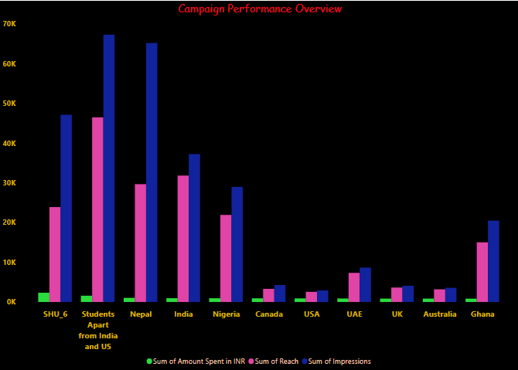
Campaign Performance Overview
Comparison of Reach, Impressions, Clicks, and Amount Spent for Each Campaign:
By analyzing this chart, we can identify which campaigns have achieved higher reach and impressions, These insights will help us make informed decisions and optimize future campaign strategies for better results

Slide 9
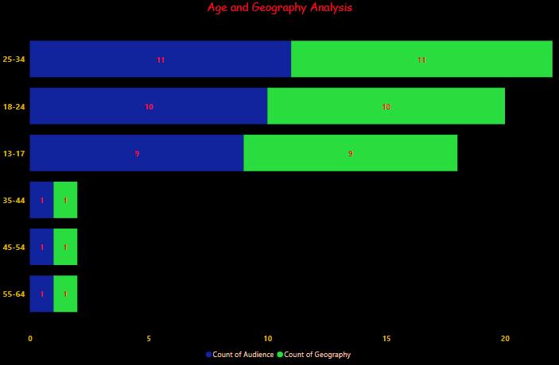
Age and Geography Analysis
Age Distribution Visualization:
age distribution of the audience for the Superhero U event.
you can use a map to visualize the regions or cities from which the attendees are coming.
You can use different colors or shading to represent the density of attendees from each location.

Slide 10
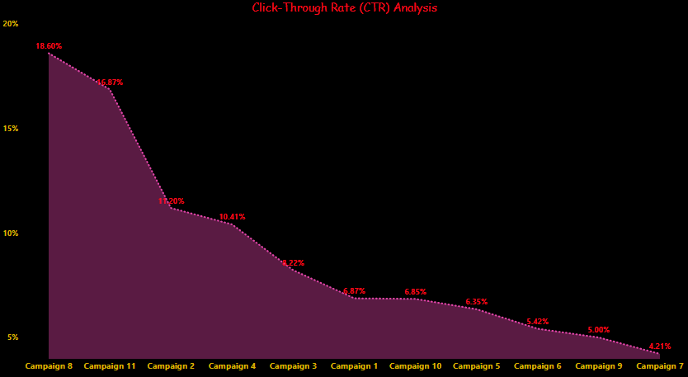
Click-Through Rate (CTR) Analysis
Line Chart for CTR Trend Over Time (if applicable):
A line chart will showcase the trend of the Click-Through Rate (CTR) over time.
The x-axis represents the time periods (e.g., days, weeks, or months), and the y-axis represents the CTR percentage.
This visualization will help us identify any patterns or fluctuations in CTR performance throughout the campaign duration.

Slide 11
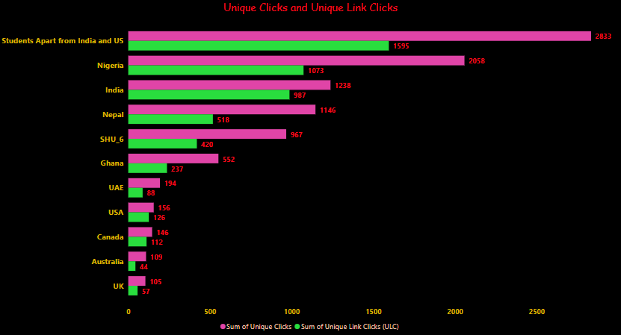
Unique Clicks and Unique Link Clicks Analysis
Campaign:
It will have two bars per campaign, one representing Unique Clicks and the other representing Unique Link Clicks.
This visualization will help us understand the engagement levels for the campaign content and the effectiveness of the shared links.

Slide 12
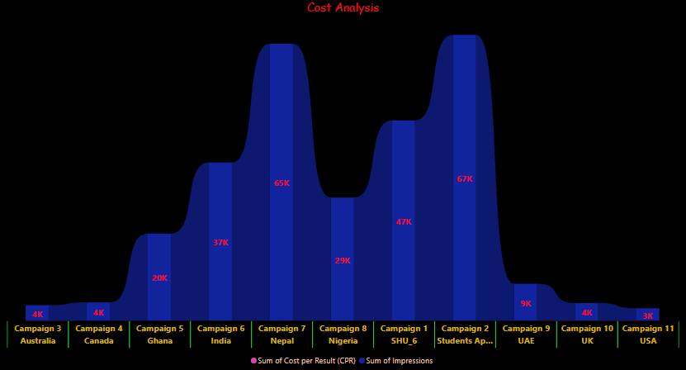
Cost Analysis
Line Chart for CPR Trend Over Time
If available, a chart can showcase the trend of the Cost per Result (CPR) over time.
The x-axis represents the time periods, and the y-axis represents the CPR value.
This chart will help us assess the cost-effectiveness of the campaigns throughout their duration.

Slide 13
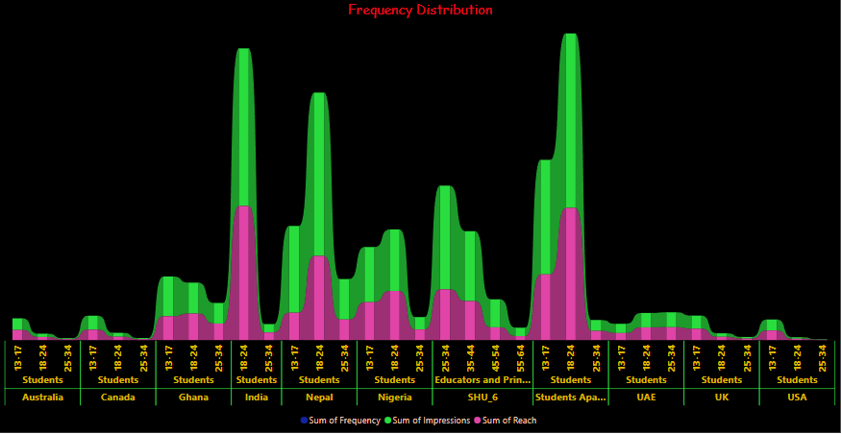
Frequency Distribution
Number of User Interactions with the Campaign:
the frequency distribution of the number of times each user interacted with the campaign.
The x-axis will show the interaction intervals (e.g., 0-5, 6-10, 11-15, etc.), and the y-axis will display the count of users falling into each interval.
This visualization will provide insights into user engagement patterns.
.

Slide 14
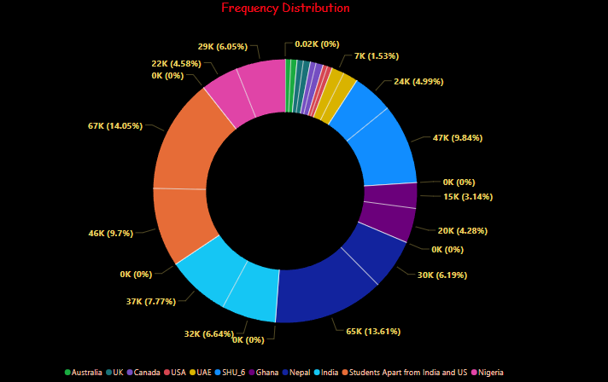
Frequency Distribution
.

Slide 15
Key Insights and Recommendations
Summary of Main Findings from the Analysis:
This slide will highlight the key insights and findings obtained from the analysis of various metrics and visualizations. It will provide a concise overview of the campaign performance.
Actionable Recommendations for Future Campaign Optimization:
The slide will outline actionable recommendations based on the analysis. It will suggest strategies to optimize future campaigns, improve engagement, and achieve better results.
.

Slide 16

By
yamuna

